Slide 1
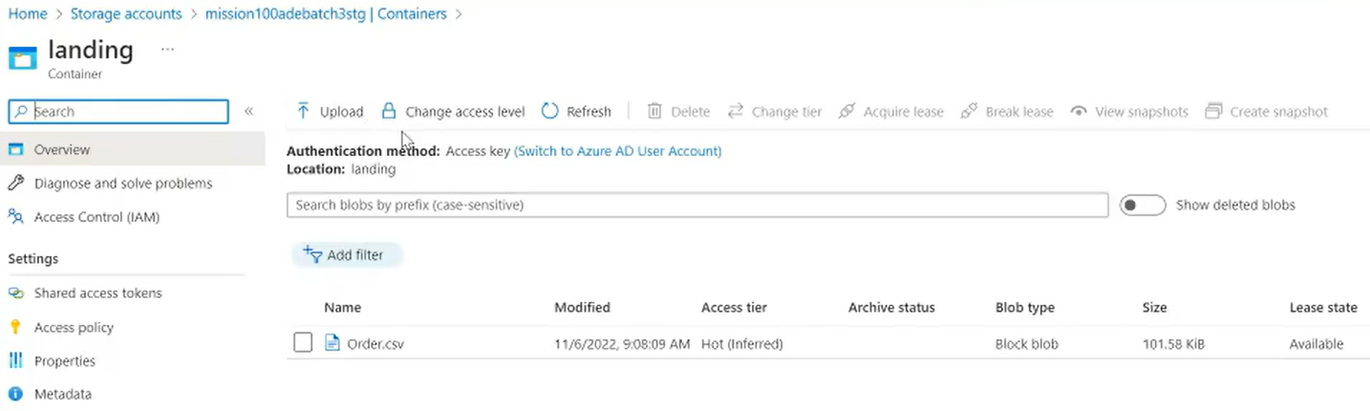
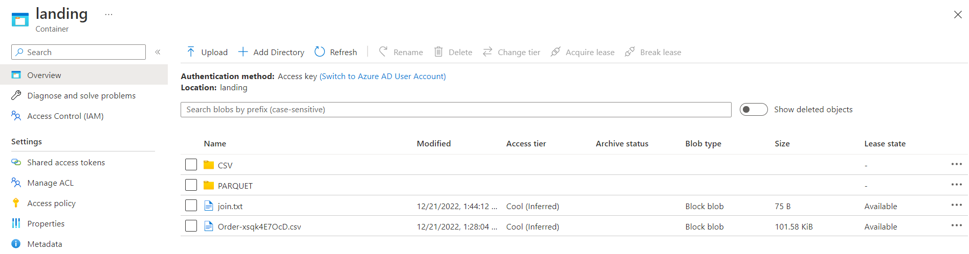
Blob Storage:
- In container i can upload only files & cann’t create folders etc.
ADLS GEN2:

Slide 2
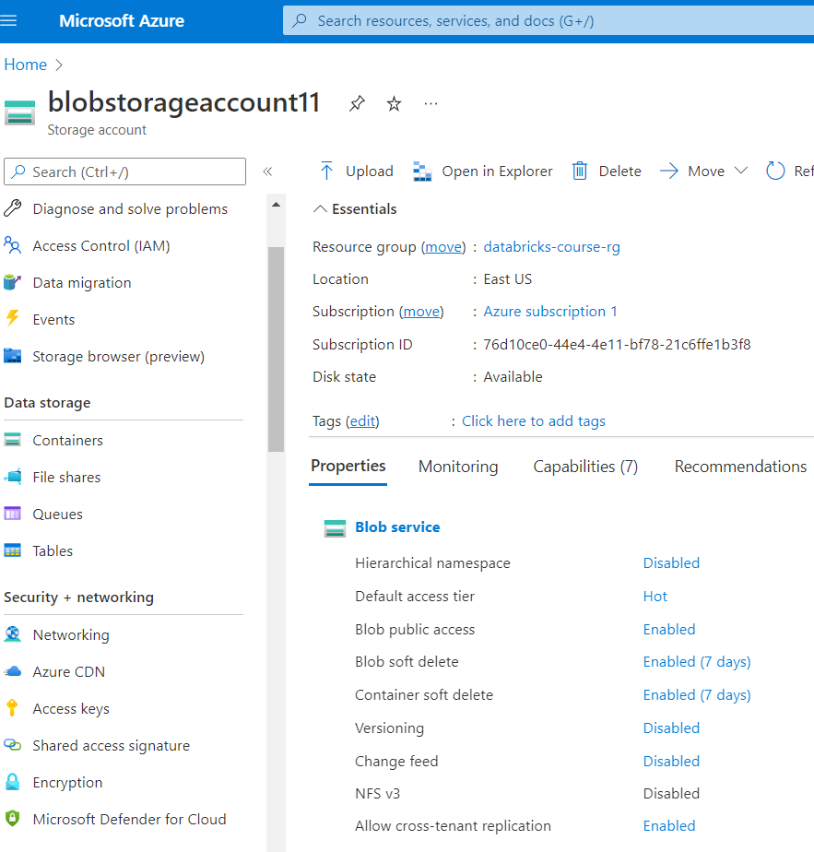
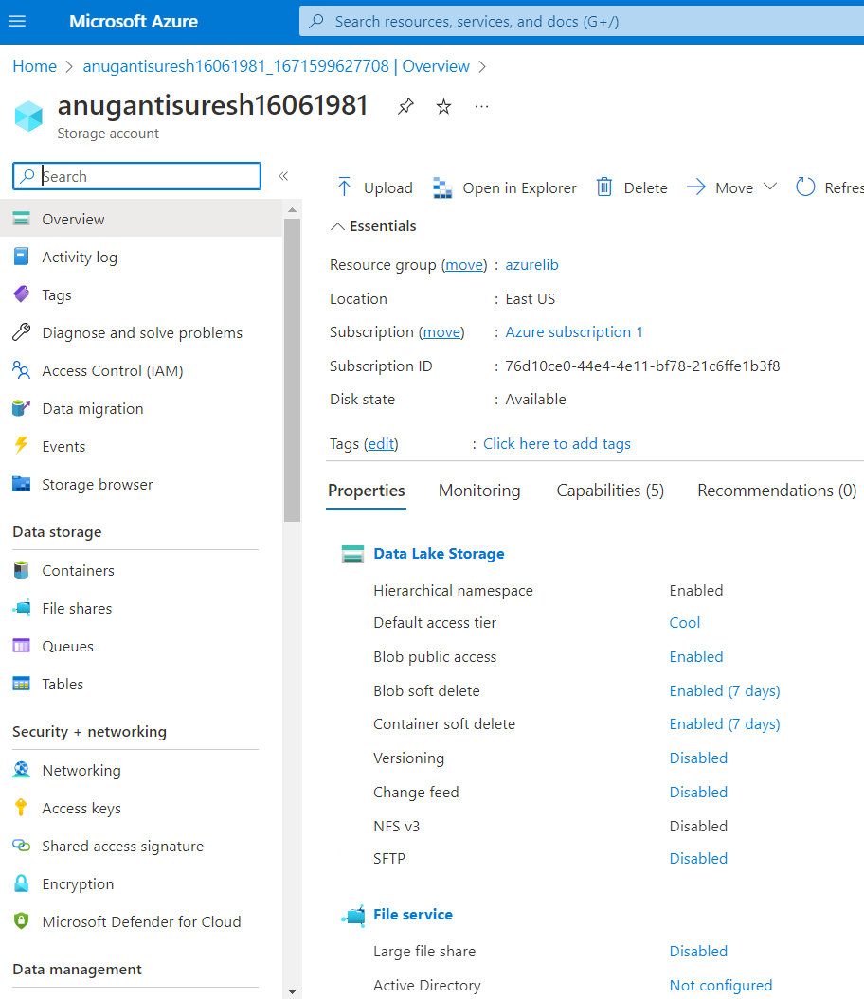
Blob Storage
ADLS GEN2

